Slide 1


How to really use Copilot Pro Part 2

Slide 2

“Life’s better with company. Everybody needs a
co-pilot.”
- George Clooney

Slide 3
Important features

Slide 4
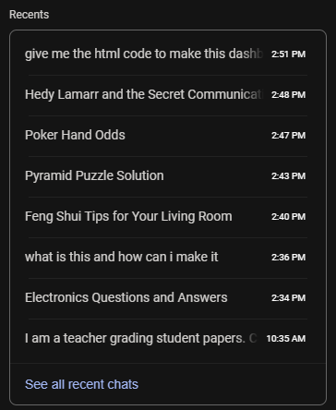
Recent questions

Slide 5

Delete all chat history

Slide 6
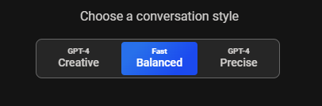
Choosing a Conversation Style (aka Temperature)

Slide 7

Asking precise Questions (prompting)

Slide 8

Asking creative Questions (prompting)

Slide 9

Writing

Slide 10


